Slide 2
Oracle Blockchain Cloud Service
Jens Lusebrink
Senior Principal Business Consultant
Jens.Lusebrink@oracle.com

Slide 3
Notes:
This is a Safe Harbor Front slide, one of two Safe Harbor Statement slides included in this template.
One of the Safe Harbor slides must be used if your presentation covers material affected by Oracle’s Revenue Recognition Policy
To learn more about this policy, e-mail: Revrec-americasiebc_us@oracle.com
For internal communication, Safe Harbor Statements are not required. However, there is an applicable disclaimer (Exhibit E) that should be used, found in the Oracle Revenue Recognition Policy for Future Product Communications. Copy and paste this link into a web browser, to find out more information.
http://my.oracle.com/site/fin/gfo/GlobalProcesses/cnt452504.pdf
For all external communications such as press release, roadmaps, PowerPoint presentations, Safe Harbor Statements are required. You can refer to the link mentioned above to find out additional information/disclaimers required depending on your audience.

Slide 4
Agenda
Introduction to Blockchain
Oracle Blockchain Cloud Service (OBCS)
Hands On Lab
1
2
2

Slide 5
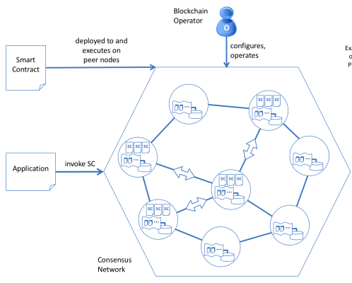
What is Blockchain
System for maintaining distributed ledgers in a peer-to-peer network
Allows multiple parties that may not fully trust one another to do business securely
Reduces need for third-party intermediaries
Near real-time and unalterable records replicated among all participants
Copyright © 2018, Oracle and/or its affiliates. All rights reserved.
5

Slide 6
Four Key Properties of Blockchains
Shared & Transparent
All participants see consistent data.
Updates replicated across participants.
Authorized participants can access their data.
Validation & Non-Repudiation
Consensus from a subset of nodes on new blocks/transactions.
Existence and validity of the record can not be denied.
Immutable
Each new block contains a hash of the previous block, giving a chain.
Distributed among participants.
Records cannot be undetectably altered or deleted, only appended.
Can be Encrypted for Confidentiality
All records are encrypted
Only those authorized to have the corresponding keys can view the data

Slide 7
Disruptive Characteristics/Benefits of Blockchain
Decentralized, peer-to-peer network – No central, controlling authority
Eliminating intermediaries means reduced transaction costs and near real-time transaction execution
Distributed ledger - All participants maintain a copy of the ledger
Eliminates manual efforts and delays due to reconciliation needs since data consistency is a key attribute of the distributed ledger
Immutable transaction history – Impossible to make changes to existing transactions in a blockchain without detection
Increased confidence in the information and reduced fraud opportunities
Smart contracts – Business logic deployed on a blockchain and shared and validated by participants.
Automated business processes in a trusted way. Represent any asset digitally.
Transparent – Transactions on a blockchain are visible to the authorized participants.
Increased auditability and trust, reduce cost of fraud and audits

Slide 8
Three Types of Blockchain
Public (a.k.a. “Permissionless”)
Permissioned
Private
Anyone can join the network and have a copy of the ledger
This involves the computer resource intensive mining process to add blocks cryptographically
Consensus models based on “proof of work”, “proof of elapsed time”, requiring a lot of processing power on many nodes
Closed ecosystem: members are invited to join and keep a copy of the ledger
Who members are in the real (legal) world is known (to at least the operators of the blockchain, but not necessarily all participants)
Consensus protocols depend on knowing who the members are, e.g., PBFT, for greater scalability
Internal to one organization only who controls all nodes
Useful for prototyping work, proof of concept and pilots

Slide 9
Agenda
Introduction to Blockchain
Oracle Blockchain Cloud Service (OBCS)
Hands On Lab
1
2
2

Slide 10
Oracle Blockchain Strategy
Securely, reliably extend business processes and accelerate B2B transactions
PRE-ASSEMBLED, ENTERPRISE-GRADE MANAGED PAAS
Rapid, global provisioning & simplified operations
Secure and confidential permissioned blockchain
Built-in IdM integration, HA, autonomous recovery, monitoring
EXTENDS ENTERPRISE BOUNDARIES
Plug-n-Play integration with Oracle SaaS and PaaS, and custom/3rd party cloud and on premises apps
Out-of-the-box API access in Netsuite ERP, Flexcube core banking, Open Banking API Platform
SAAS BLOCKCHAIN APPLICATIONS
Supply chain track & trace use cases and more
SMART CONTRACTS
PRIVACY
CONSENSUS
DISTRIBUTED LEDGER

Slide 11


Effort Required To Deliver Enterprise–Grade Blockchain
Validating Nodes/ Peers
Distributed Ledger
(Single Version of Truth)
Smart Contract (aka Chaincode)
Applications
(Client SDK)
Ordering Service
Membership Service
async
Bring your own…
Identity Management
(for member enrollment)
Fault Tolerant Event Hub (for ordering event mgmt.)
Container Lifecycle Management (for system and chaincode containers)
Configuration & Monitoring Tools
Autonomous Recovery
(when components fail)
Managed Patching & Upgrades
Elastic scaling on demand
Multi-datacenter DR (with backup of ledger and config info)
Notes:
From an enterprise perspective, we are looking at permission blockchain here we need someone to authorize someone to identify. Everyone has to be identified to show who is participating on the blockchain and what transactions they are executing.
<Click1>
So, first component of course are the peer nodes. Nodes represent an organization. Blockchain is basically a business network that you are creating and there are multiple organizations participating in that. You can't have just one node in the blockchain network there have to be multiple nodes and these nodes are talking to each other over the network. It could be over the internet could be something else. So these are the nodes which are representing organization doing most of the work.
<Click2>
Of course the blockchain is a distributed ledger technology there has to be a ledger with each of the nodes. Each node maintains its own ledger -- that's where all the transaction information is stored.
<Click3>
How this information is stored is through a smart contract. A smart contract is the piece of business logic that is executed on these nodes and it looks at the world state and based on that it updates the ledger.
<Click4>
Ordering service is the centralized point of trust in a decentralized network. Ordering service helps to construct and maintain ledgers as a totally ordered hashchain of blocks of transactions that provides a verifiable history of state changes.
<Click5>
This is a permission block chain. For permission blockchain there has to be some sort of membership services and entity services which can say only these people are authorized to participate in this blockchain network. Not anyone can do a transaction -- anonymity is a feature of Bitcoin that's how Bitcoin came up because you don't want to be identified when you are doing transaction over the Bitcoin which you can be anonymous. But on this permission blockchain you have to be identified that's and there has to be a membership service there.
<Click6>
In our service we have a REST proxy to serve up APIs from the platform for applications. Using REST APIs reduces the programming complexity considerably compared to using Hyperledger Fabric SDKs directly.
<Click7>
Then if we have so many components you need some sort of admin console – some sort of monitoring tool that using which you can monitor your network. You update your network to the administration tasks
and so on so there has to be an administration console.
<Click8>
Last but not least, you have to have the end-user applications which are talking into the blockchain network so these applications can use that various API is to invoke the smart contract which will start a transaction on the blockchain network.
This is what a blockchain network component would look like in any platform.
<Click9>
All these capabilities are offered as a fully managed PaaS Cloud Service that is managed by Oracle.

Slide 12
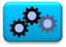

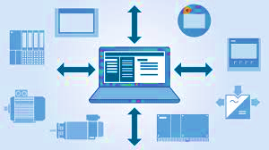

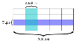


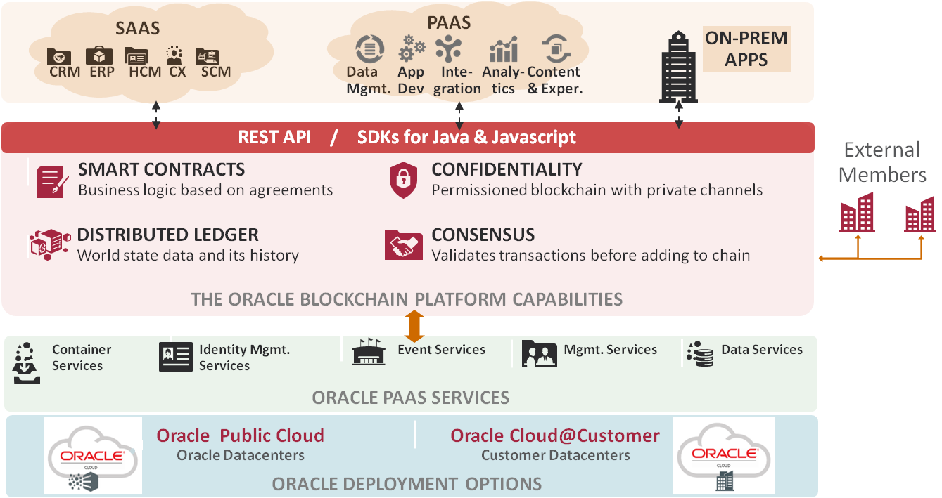
Comprehensive Blockchain Platform
Validating Nodes/ Peers
Distributed Ledger
(Single Version of Truth)
Smart Contracts (aka Chaincode)
Applications
REST proxy
P
Ordering Service
REST
Membership Service
Membership Service
SDK
Oracle value-add
Pre-assembled Dependencies
REST Proxy
App
App
Ordering Service
Admin/Operations Console
Integrated backplane of supporting services
P
P
Rich integration tools for SORs & new apps
Operations
SQL-based rich queries over K-V ledger
Autonomous, Oracle-managed PaaS
Flexible, global, interoperable deployments
Notes:
From an enterprise perspective, we are looking at permission blockchain here we need someone to authorize someone to identify. Everyone has to be identified to show who is participating on the blockchain and what transactions they are executing.
<Click1>
So, first component of course are the peer nodes. Nodes represent an organization. Blockchain is basically a business network that you are creating and there are multiple organizations participating in that. You can't have just one node in the blockchain network there have to be multiple nodes and these nodes are talking to each other over the network. It could be over the internet could be something else. So these are the nodes which are representing organization doing most of the work.
<Click2>
Of course the blockchain is a distributed ledger technology there has to be a ledger with each of the nodes. Each node maintains its own ledger -- that's where all the transaction information is stored.
<Click3>
How this information is stored is through a smart contract. A smart contract is the piece of business logic that is executed on these nodes and it looks at the world state and based on that it updates the ledger.
<Click4>
Ordering service is the centralized point of trust in a decentralized network. Ordering service helps to construct and maintain ledgers as a totally ordered hashchain of blocks of transactions that provides a verifiable history of state changes.
<Click5>
This is a permission block chain. For permission blockchain there has to be some sort of membership services and entity services which can say only these people are authorized to participate in this blockchain network. Not anyone can do a transaction -- anonymity is a feature of Bitcoin that's how Bitcoin came up because you don't want to be identified when you are doing transaction over the Bitcoin which you can be anonymous. But on this permission blockchain you have to be identified that's and there has to be a membership service there.
<Click6>
In our service we have a REST proxy to serve up APIs from the platform for applications. Using REST APIs reduces the programming complexity considerably compared to using Hyperledger Fabric SDKs directly.
<Click7>
Then if we have so many components you need some sort of admin console – some sort of monitoring tool that using which you can monitor your network. You update your network to the administration tasks
and so on so there has to be an administration console.
<Click8>
Last but not least, you have to have the end-user applications which are talking into the blockchain network so these applications can use that various API is to invoke the smart contract which will start a transaction on the blockchain network.
This is what a blockchain network component would look like in any platform.
<Click9>
All these capabilities are offered as a fully managed PaaS Cloud Service that is managed by Oracle.

Slide 13


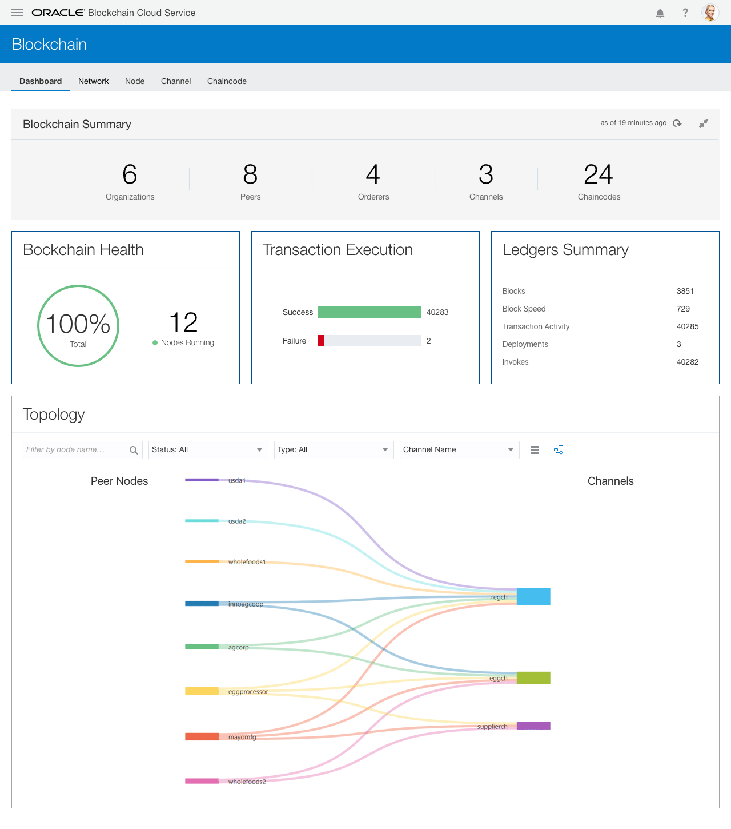

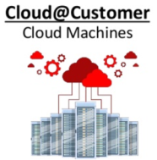
Oracle Blockchain Solution
Industrialized, hardened blockchain cloud platform for enterprise
Pre-assembled | Managed service | Production-ready | Public or private cloud
SaaS
REST
REST APIs for Integrations
Administration
Dynamic Configuration,
Monitoring and Troubleshooting
REST
gRPC
gRPC
On Premises
PaaS
Blockchain Nodes & Containers
Peer Nodes, Smart Contract Containers, Membership Services, Ordering Service, REST Proxy
Data Services
Object Store CS
NoSQL DB CS
Public Cloud
IaaS, SaaS, PaaS
Infrastructure and PaaS Services
Application Container CS (Managed Docker Containers), Identity CS (identity and key mgmt),
Event Hub CS (Kafka service), Management Service

Slide 14


Oracle Blockchain Cloud Service
Hardened for enterprise applications
Oracle SaaS
3rd Party SaaS
Custom Cloud Apps
CRM
ERP
HCM
CX
SCM
On-Premises Apps
Hyperledger Fabric Peers
in customer data centers or 3rd party clouds
Oracle Blockchain Cloud Platform
REST API SDKs for Go, Java, and Node.js OIC Adapters
Pre-Assembled
Governance*
Pre-Assembled
Smart Contracts
Confidentiality
Open
Open
Distributed Ledger
Consensus
Plug-n-play Integrations
Plug and Play
Open Source Hyperledger Fabric
Enterprise-Grade
Oracle Cloud Infrastructure and PaaS Services
Enterprise-Grade
Container Services
Identity Management
Events
Management Services
Data Services
Consortium Members
satellite nodes for private ledger data*
Oracle-managed PaaS
*coming soon

Slide 15
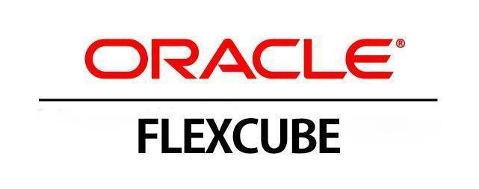
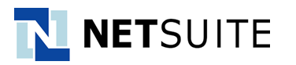

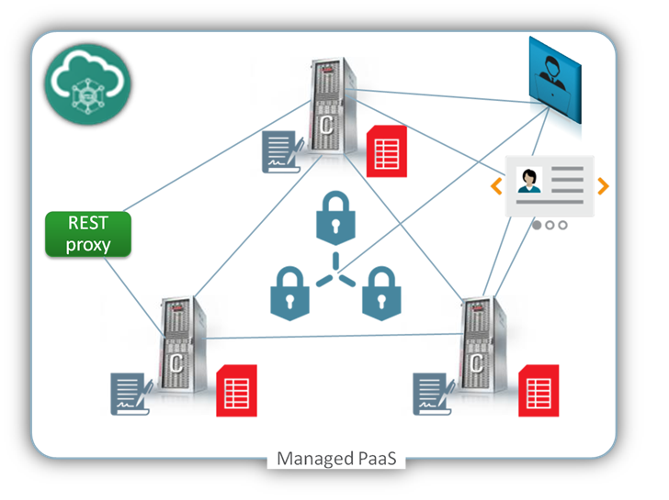



Integration Accelerators for OBCS
Legend
On-premises
ON-RAMPS WITH EMBEDDED APIS
SaaS
PaaS
Public or private cloud
OPEN BANKING API PLATFORM
SAAS APPLICATION INTEGRATION TOOLKITS
Sample templates & design patterns
Sample smart contracts & integration components
SaaS
PaaS
REST API-DRIVEN INTEGRATION
Invoke txn’s in sync & async mode
Get txn status
Query ledger data
SaaS
ORACLE INTEGRATION CLOUD
Adapters for Oracle & 3rd party applications in cloud and on-prem
Turn application events into REST calls to run blockchain transactions
SaaS
PaaS
PaaS
JAVA AND NODE.JS CLIENT SDKS
Invoke txn’s async
Get txn status
Query ledger data
Subscribe to events
Add channels/peers
Enroll new members
App
App

Slide 16
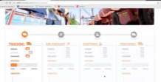
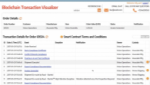

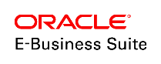
Oracle Integration Accelerators in Action
Java App
SMART CONTRACTS
Order Management
Cloud
REST
PRIVACY
CONSENSUS
DISTRIBUTED LEDGER
Blockchain Cloud Service
EVENTS
Planning Central
Cloud
PaaS
Java Cloud Service (JCS
Content & Experience (CX)
Manufacturing
Cloud
REST
REST
PaaS
Procurement
Cloud
REST Adapter
REST Adapter
Receivables
Cloud
ERP Cloud Adapter
E-Business Suite Adapter
EVENTS
EVENTS
SAP, JDE, etc.
SCM Cloud
Integration Cloud Service
Integration Cloud Service
SaaS
PaaS
PaaS
IaaS or On Premises
Notes:
Oracle Blockchain Cloud Service is deployed in our PaaS Cloud environment
Providing business network with peer nodes for the participants
SCM Cloud on the left and eBusiness Suite on the right
Both of these use BPEL Events to notify adapters in the Integration Cloud Service
ICS then uses REST APIs to run transactions on the Blockchain to update and query the ledger, triggering the smart contracts
We can also integrate our Java Cloud Service or Content & Experience Cloud, which can be used for custom apps and visualization/tracking tools

Slide 17
Oracle Blockchain Applications Cloud
Intelligent
Track and Trace
Lot Lineage and Provenance
Intelligent
Cold Chain
Warranty and Usage Tracking
Monitor transactions and movement of assets or goods across organizations
Pedigree, Serialization and Genealogy of product components
Comprehensive Track and Trace system for food and pharmaceuticals safety
Product usage tracking for Rental, Warranty, Service, & Insurance for high-value assets
Smart Contracts, Distributed Ledger on Blockchain Platform
Shipment Notifications, Bill of Lading, Manufacturing work orders
Purchase order, Sales order
Service records, Warranty information
Assets, Equipment and cargo conditions, Predictive Insights
Sources of Input
Supply Chain
ERP
HCM
Customer Experience
Internet of Things
Notes:
Intelligent Track and Trace:
A full track and trace solution
Monitor the movement of assets or goods
Create a digital paper trail of each step in manufacturing, each leg of transportation, and each event throughout the supply/value chain
Pre-built analytics to help manage supply chain operations
Lot Lineage and Provenance:
Verify origin and authenticity of a product as it moves throughout the value chain
Pedigree, Serialization & Genealogy through automated capture of information about all transformations of a product
Auditable visibility and traceability into product history
Intelligent Cold Chain:
Monitor condition of goods from manufacturer all the way to the point of sale
A full track and trace solution for food and pharmaceuticals safety
Reactive and Predictive alerts of excursions
Auditable trail of all events
Outbreak preventative recommendations and root-cause analysis
Warranty and Usage Tracking:
Product usage tracking for Rental, Warranty, Service, and Insurance needs for high-value assets
Undisputable records for rented/leased product usage tracking
Auditable and verifiable log of product usage for warranty, liability claims
Increased customer satisfaction, reduced legal liabilities

Slide 18
Agenda
Introduction to Blockchain
Oracle Blockchain Cloud Service (OBCS)
Hands On Lab
1
2
2

Slide 19
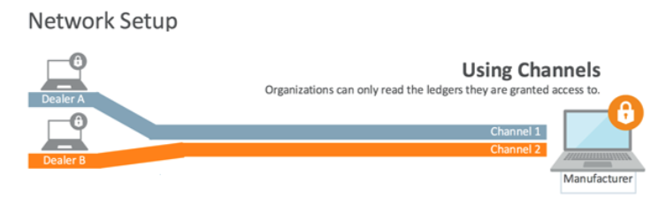
BCS Interactions – HOL Scenario
Large automaker, collaborating with his dealers.
Creating and Audit Trail / network of trust to track parts and vehicles
Using channels to exchange information with various dealers
Channels also hide details from other dealers but still create trust among channel participants.

Slide 20
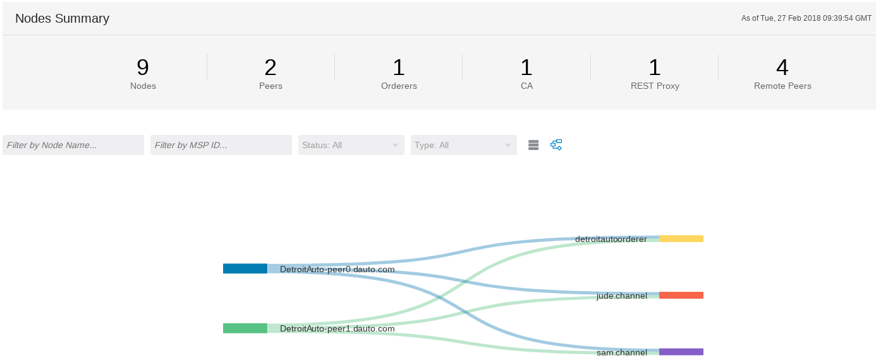
BCS Dealer Network setup
Network
Founder & Participants created and connected via separate channels
Chaincode / Smart Contract
Chaincode created and instantiated on all channels
Transactions
Initial load of sample transactions, blocks created

Slide 21
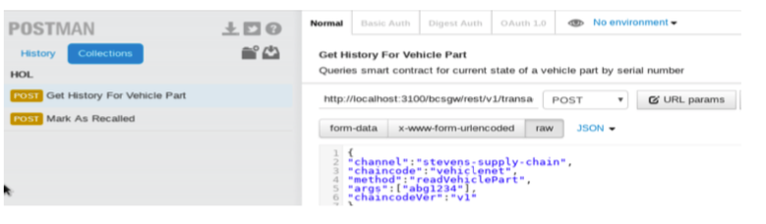
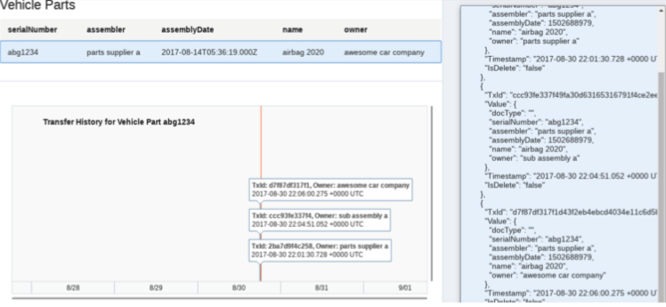
Working with the BCS network
REST API-DRIVEN INTEGRATION
Query ledger data
Invoke transactions
Get transaction status
Working with Postman
Using the REST API to work on the Blockchain
Working with sample apps
Visualizing BC / Ledger information

Slide 22
HoL Step by Step
Play the Blockchain Network Administrator
Create the Network Founder and the Organizations
Meet your HoL cloud instance
Connect to the internet
Be a Blockchain USER
Load initial values into your BC
Get the connection token
Check your instance access info
Import Orderer Settings
Share organization certificates
Create Channels
Deploy Smart Contracts
Invoke Smart Contracts by REST API
Use Client applications

Slide 23
Oracle Blockchain Cloud Service
Q&A
The most comprehensive distributed ledger cloud platform to securely extend your business processes and conduct online transactions in trusted networks with your suppliers, banks, and other trade counterparties
For more information:
Oracle.com/blockchain
Cloud.oracle.com/blockchain

